Slide 1

Project on :
Grocery Store Management System
Presented by: P. Manohar Reddy

Slide 2


About me
My name is P. Manohar Reddy, a CSE (Artificial Intelligence) student with a strong interest in data analytics and problem-solving. I aim to build my career as a Data Scientist, with a focus on applying SQL, AI, and analytical techniques to real-world datasets.
Key Skills:
SQL & Database Management
Data Analysis & Visualization
Python (Basics)
Problem-Solving & Critical Thinking

Slide 3
Introduction
This project presents an end-to-end analysis of a Grocery Store Management System using SQL. The goal is to extract meaningful insights related to customer behavior, product performance, sales patterns, supplier contribution, and employee efficiency.
Using SQL queries, the raw database was transformed into actionable insights that support better decision-making in inventory, marketing, and operations.

Slide 4
Project Objectives
Analyze customer purchase behavior
Identify top-selling and high-revenue products
Study monthly and daily sales patterns
Understand supplier contributions
Evaluate employee performance
Derive insights for better business decisions

Slide 5
Dataset Overview
Database contains the following tables:
Customers
Products
Categories
Suppliers
Employees
Orders
Order_Details
Total Records:
Unique customers: 156
Total orders: 300
Products analyzed: multiple categories

Slide 6
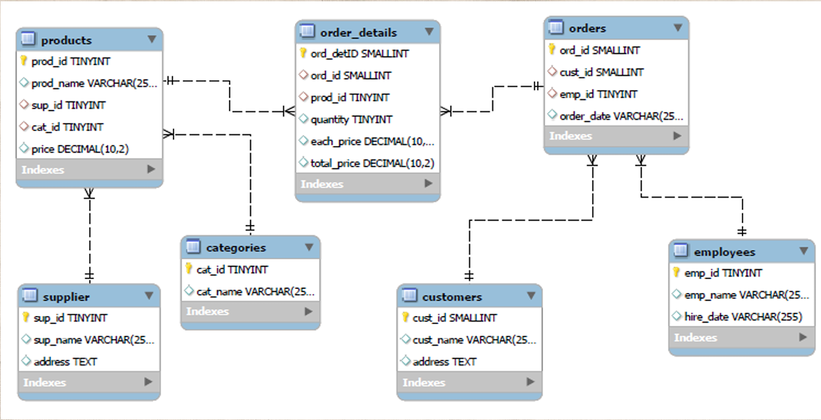
ER DIAGRAM

Slide 7
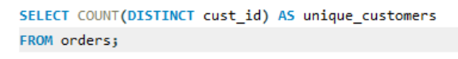
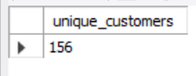
Customer Insights
Number of unique customers have placed orders

Slide 8
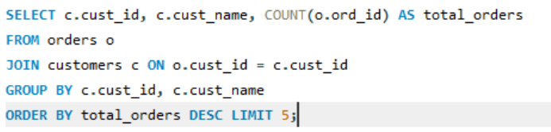
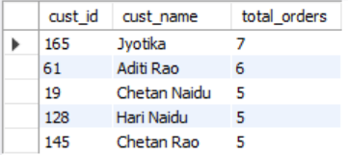
The customers who placed the highest number of orders

Slide 9
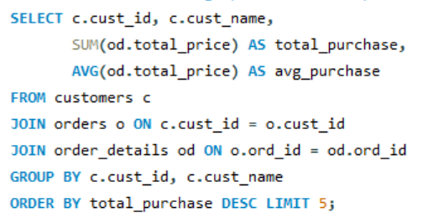
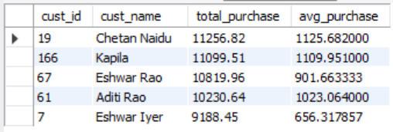
The total and average purchase value per customer

Slide 10
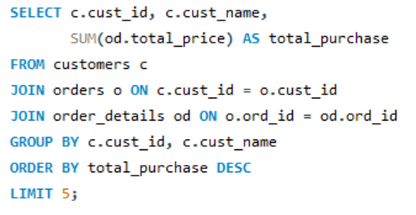
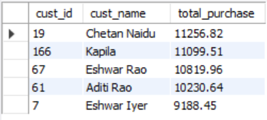
The Top 5 customers by total purchase amount

Slide 11
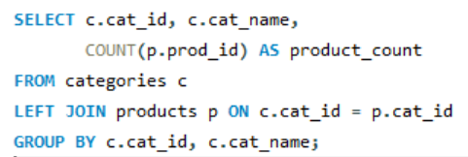
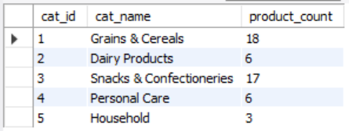
Product Performance
How many products exist in each category

Slide 12
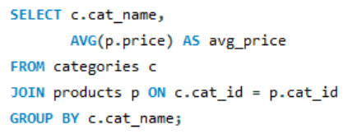
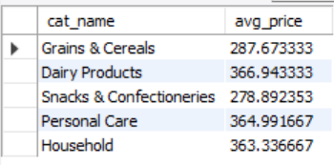
Average price of products by category

Slide 13
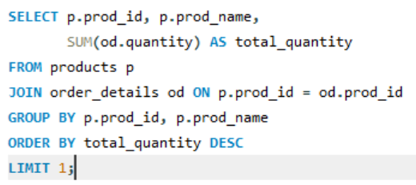
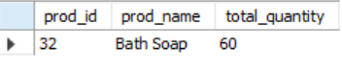
Product with highest total sales volume (by quantity)

Slide 14
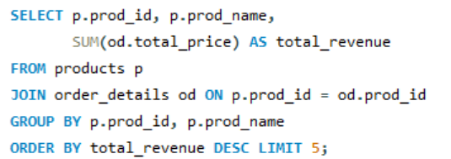
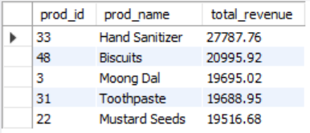
Total revenue generated by each product

Slide 15
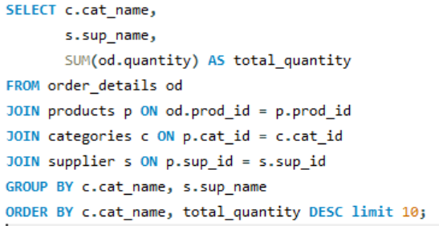
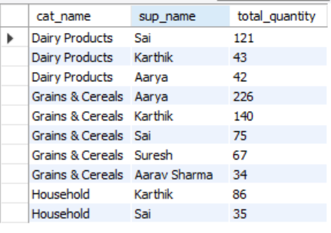
Product sales by category and supplier (quantity)

Slide 16
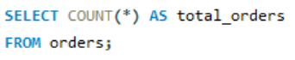
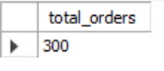
Sales and Order Trends
Total number of orders

Slide 17
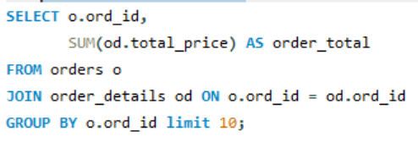
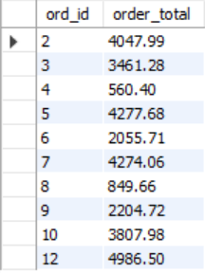
Average value per order

Slide 18
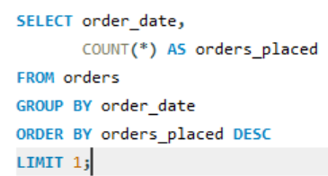
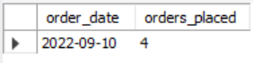
Date with most orders

Slide 19
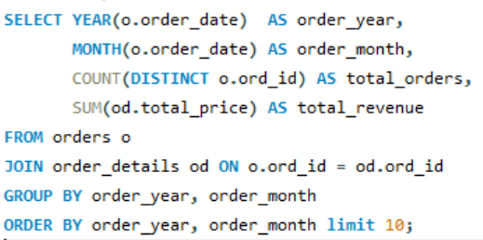
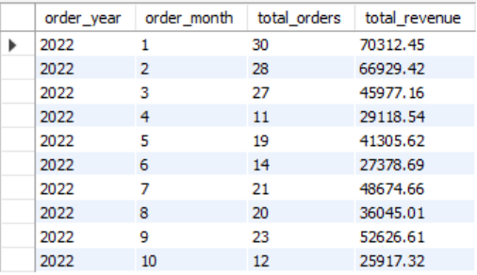
Monthly trends in order volume and revenue

Slide 20
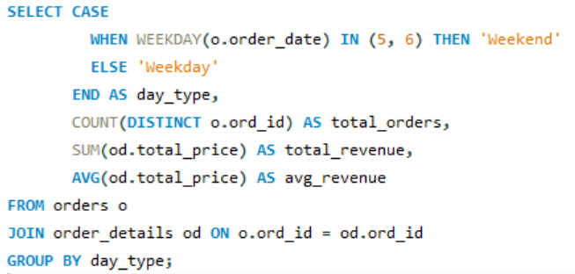
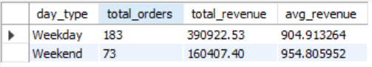
Weekday vs weekend patterns

Slide 21
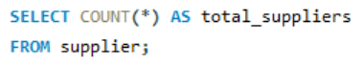
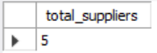
Supplier Contribution
Number of suppliers

Slide 22
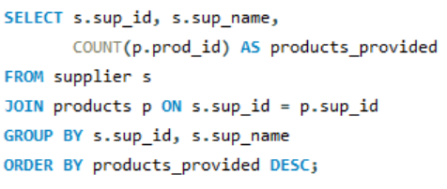
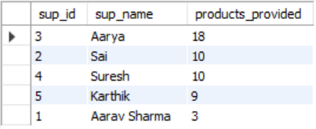
Suppliers providing the most products

Slide 23
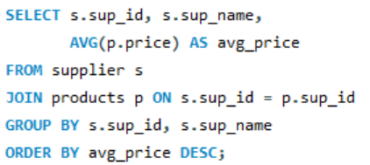
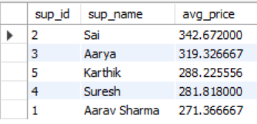
Average price of products from each supplier

Slide 24
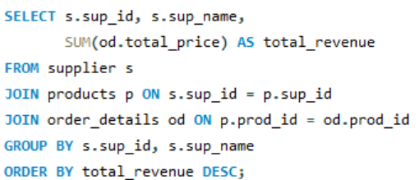
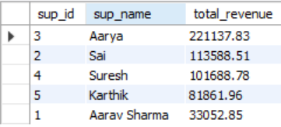
Suppliers contributing most to sales (by revenue)

Slide 25
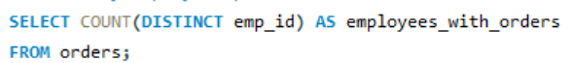
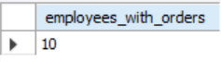
Employee Performance
How many employees processed orders?

Slide 26
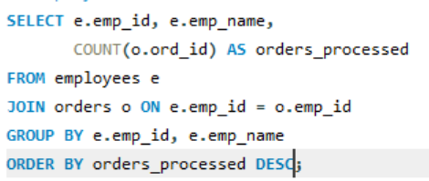
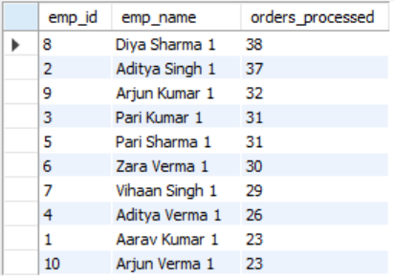
Employees who handled the most orders

Slide 27
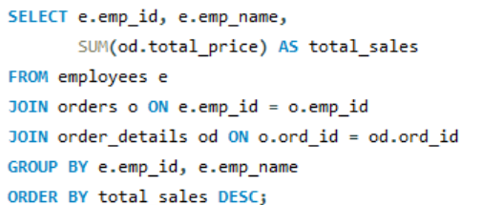
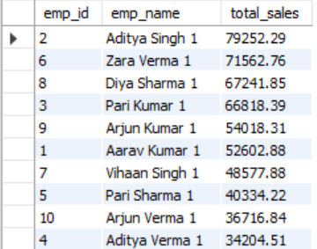
Total sales value processed by each employee

Slide 28
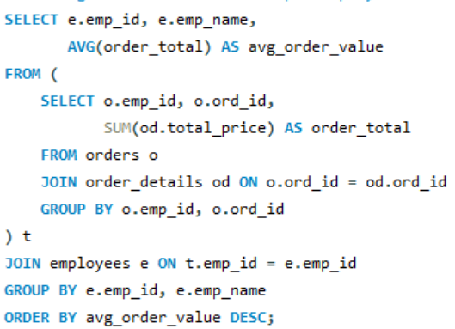
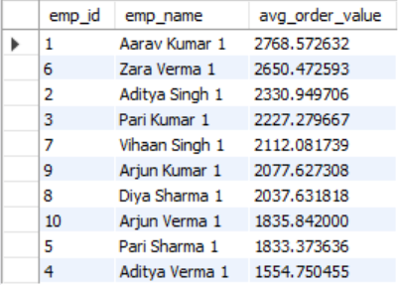
Average order value handled per employee

Slide 29
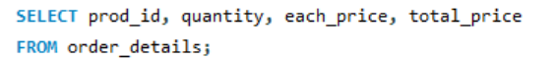
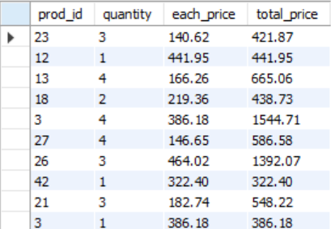
Order Details Deep Dive
Relationship between quantity and total price (raw view)

Slide 30
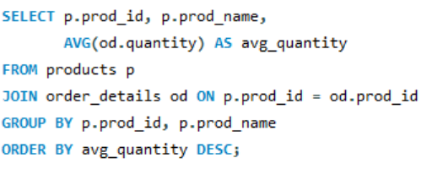
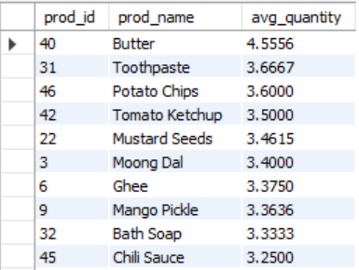
Average quantity ordered per product

Slide 31
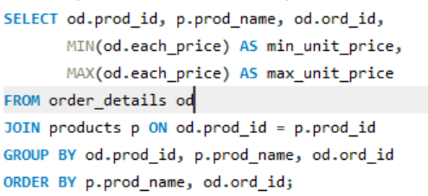

Unit price variation across products and orders

Slide 32


Products most frequently purchased in bulk (quantity >= 5)

Slide 33
Project Summary
Analyzed the Grocery Store Management System using SQL.
Explored customer behavior, including high-value and frequent buyers.
Identified top-selling products and highest revenue generators.
Studied sales patterns, including monthly trends and weekday vs weekend demand.
Evaluated supplier contributions, highlighting key partners.
Assessed employee performance based on order processing activity.
Derived clear insights that support business decisions, inventory planning, and customer engagement.

Slide 34
Conclusion
This SQL-based analysis provided a deep understanding of grocery store operations across customers, products, sales, suppliers, and employees. Key findings indicate that:
A small group of high-value customers drives a major share of total revenue.
Household essentials and packaged foods dominate both sales volume and revenue.
Weekdays outperform weekends in order activity, showing stable daily demand.
Supplier “Aarya” plays a crucial role in overall product availability and sales performance.
Top employees contribute significantly to operational efficiency.
Overall, the study highlights how structured SQL analysis can transform raw transactional data into actionable insights that support better decision-making and store performance.

Slide 35

THANK YOU

